Slide 1
Exploring Motivations for Identifying as a Religious None
Gabriel Brown

Slide 2
Brief Overview
We have seen that religion is often a source of controversy and a catalyst for social movements.
Ideas about religion and moral beliefs begin forming by the age of three.

Slide 3
Formation of Religious Ideas
Children will associate with other children of similar ideology, including religion.
Religious beliefs prior to adolescence closely mimic those of the parents

Slide 4
Muller-Lyer Illusion
Children are presented with the figure to the right, and asked which line is longer.
Can you guess?

Slide 5
Three Categories of Motivations
Psychological
Social
Political

Slide 6
Psychological
The majority of nones still maintain a level of faith (“unchurched”).
Interests in spirituality as a form of religion has increased in the last decade.

Slide 7
Social
The majority of nones (63% according to Pew) state that religion can be a force for good in society; their issue is with religious leaders, not religion.
Nones are generally college-age (younger than 30), mobile, single, and from urban areas.

Slide 8
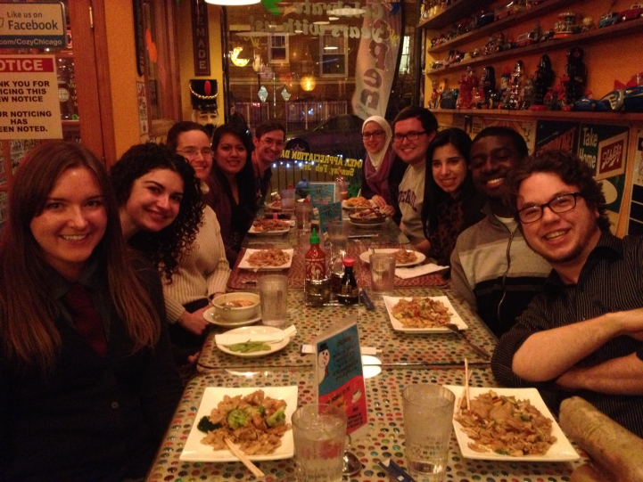
Social (contd.)
The importance of individuality in Western cultures may uphold disassociation from religion as a form of identification.
Nones tend to have fewer family social ties, and more social ties beyond the family.

Slide 9
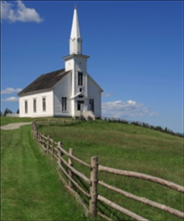
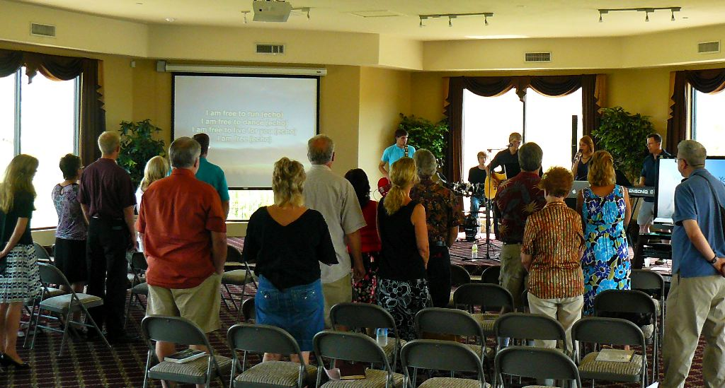
Social (contd.)
“Fringe” churches show greater retention rates.

Slide 10
Social/Political Transition
Structural
Cultural
Working class
Typically less educated
Pre-1960
Take issue with the leadership of religious organizations and their political agendas
Upper class
Typically well-educated
Post-1960
Having developed differing ideas, especially of morality, drift away from organized religion

Slide 11
Political
There is a general distrust in macro-organizations.
The majority of nones agree that religious organizations are too focused on politics, money, power, and rules.

Slide 12
Effects
Many churches are modifying youth group activities in order to attract and retain members from a younger age.
Potential modification of political agenda
Religion might evolve to be more of a generalized set of moral precepts and codes

